Slide 1
CS4101 Introduction to Embedded Systems Lab 7: Arduino Basics
Prof. Chung-Ta King
Department of Computer Science
National Tsing Hua University, Taiwan

Slide 2
Outline
In this lab, we will learn basics of Arduino
GPIO
Interrupt and timers
Serial communication to/from PC
Pushbutton bounce problem
Random number
You can reference GPIO、interrupt and timers in
Lecture 09

Slide 3
Serial Communication to/from PC
Serial communication
The Arduino IDE has a feature called “Serial Monitor”, which is a separate pop-up window that acts as a terminal to communicate with the Arduino UNO by receiving and sending serial data
Arduino’s serial library supports serial communication
Serial.begin() - start serial port and set baud rate
Serial.println() - transmit the data to PC
Serial.read() - receive the data from PC

Slide 4
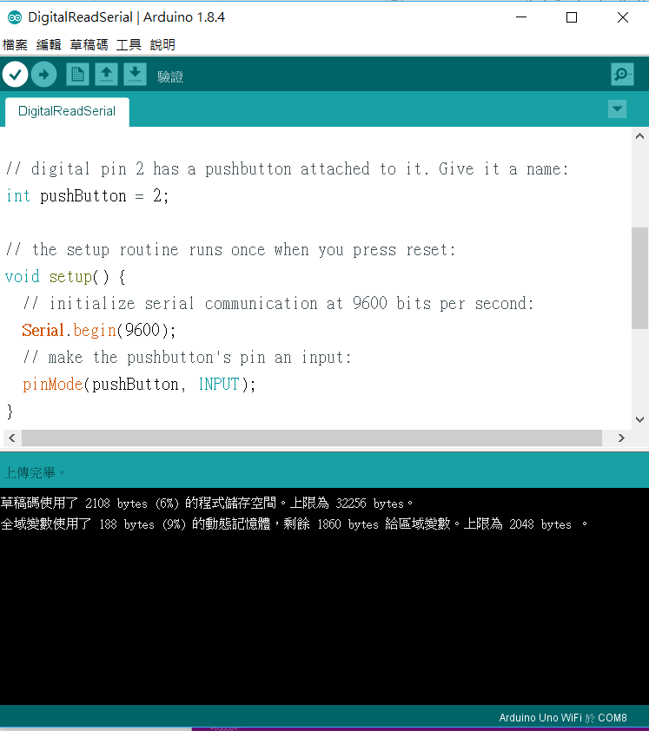
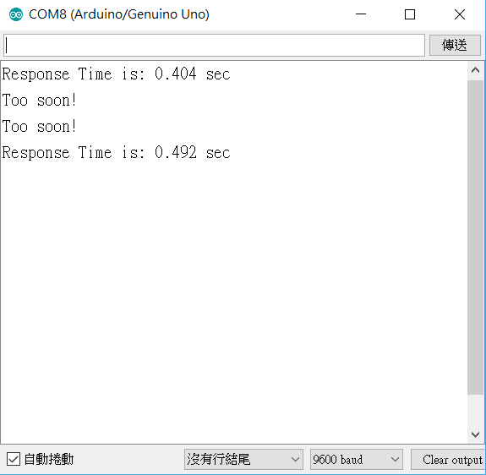
1. Open the monitor
2. Select the correspond baud rate

Slide 5
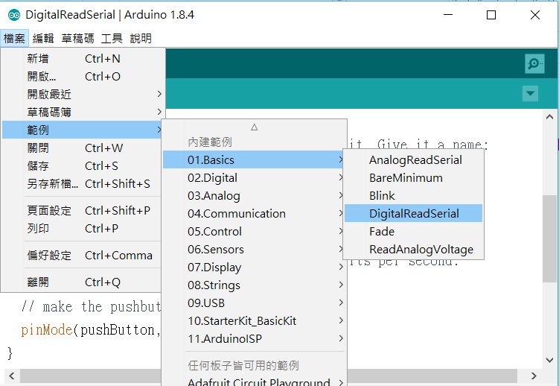
Sample Code for Serial Communication
File → Example → 01.Basic → DigitalReadSerial

Slide 6
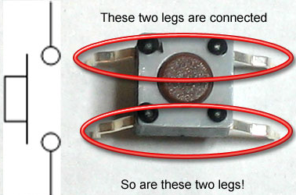
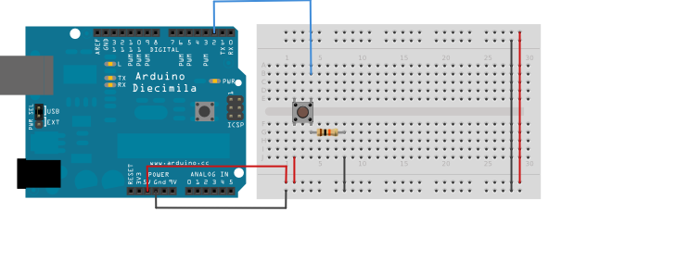
Pushbutton Switch
Pushbutton internal:
Button connection: 10K ohm resistor in series
(http://www.ladyada.net/learn/arduino/lesson5.html)

Slide 7
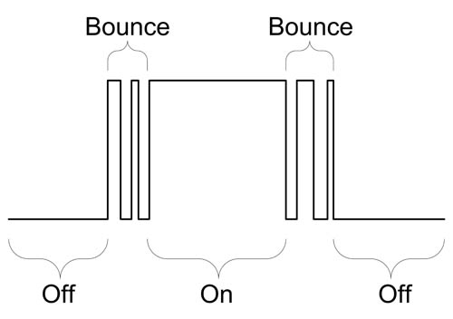
Pushbutton Bounce Problem
Pushbutton bounce:
Push buttons often generate spurious open/close transitions when pressed due to mechanical and physical issues
These transitions may be read as multiple presses in a very short time, which cause the program to confuse.
The problem can be solved with hardware or software.
A simple idea for debouncing: check twice in a short period of time to make sure the pushbutton is definitely pressed.
(http://www.protostack.com/blog/2010/03/debouncing-a-switch/)

Slide 8
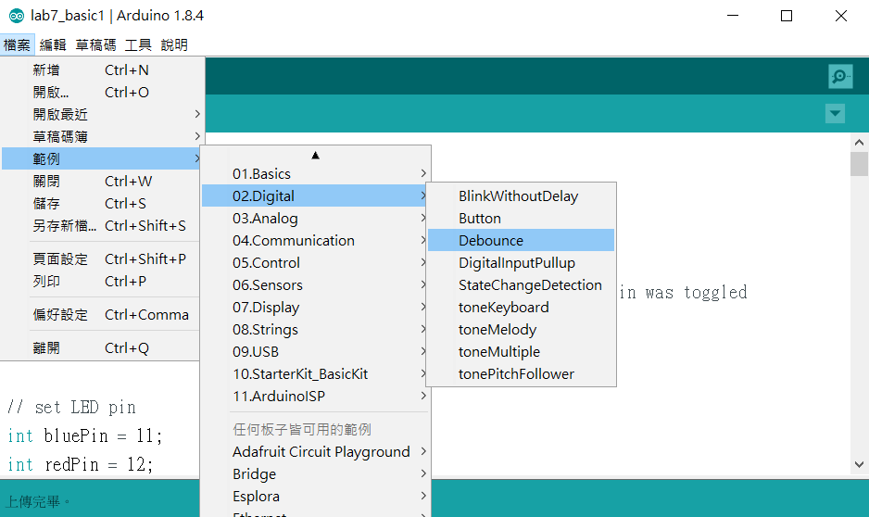
Sample Code for Debouncing
File → Example → 02.Digital → Debounce

Slide 9
Random Number Generator
Set random seed:
Initializes the pseudo-random number generator, causing it to start at an arbitrary point in its random sequence.
You can use an analog PIN as the seed.
void setup() {
randomSeed(analogRead(A0));
// your code
// ...
// ...
}

Slide 10
Random Number Generator
random():
Syntax
random(max)
random(min, max)
Parameters
min - lower bound of the random value, inclusive (optional)
max - upper bound of the random value, exclusive
Returns
a random number between min and max-1 (long)
void loop() {
delayTime = random(5, 10);
// your code
}

Slide 11
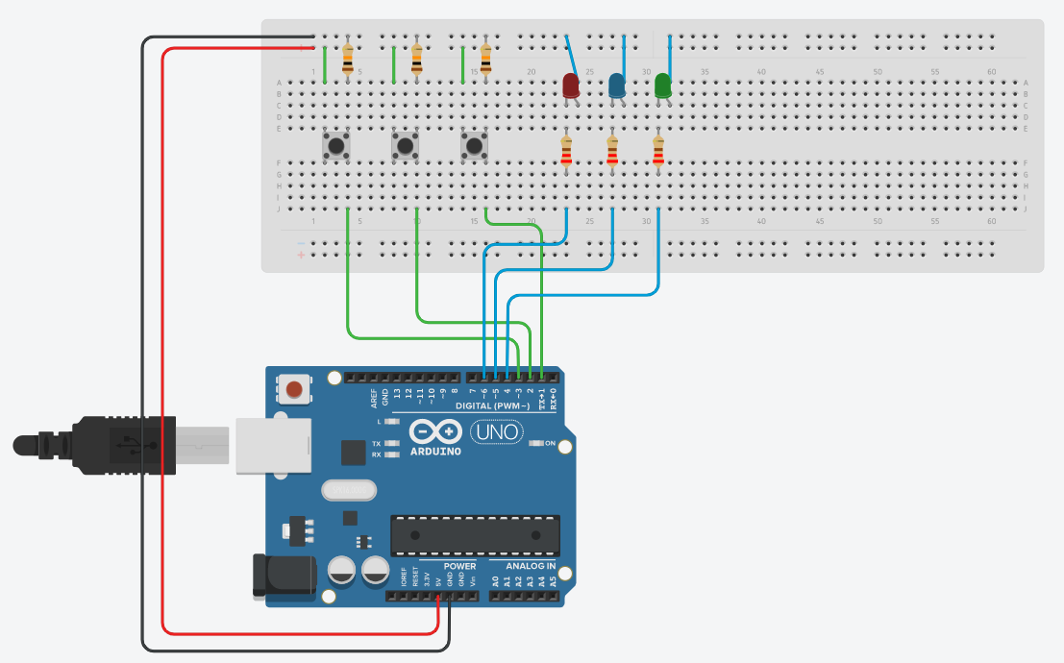
Lab 7
Basic 1: (60%)
Connect 3 buttons to 3 LEDs (red, blue, and green).
Resistor suggestion:
For LED: 220 ohm in series
For button: 10K ohm in series

Slide 12
Lab 7
Basic 1: (cont.)
When a button is pressed, turn on the corresponding LED and measure the pressed time, regardless of the state of the LED before the button is pressed.
As soon as the button is released, show the pressed time on the PC and flash the corresponding LED at 1Hz (on 0.5 sec and off 0.5 sec) for the same amount of time.
You must handle the following cases correctly:
Button debounce
Two or more buttons are pressed (may not simultaneously)
When an LED is flashing in responding to the previous button-press and the button is pressed again

Slide 13
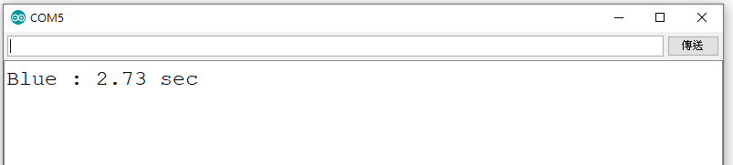
Lab 7
Basic 1: (cont.)
Sample output on the PC:

Slide 14
Lab 7
Basic 2: (15%)
List all possible states and their transitions on a separate sheet of paper.
Basic 3: (25%)
Control all timers by setting the timer registers instead of calling Arduino library functions, such as delay().

